Slide 1


Marathwada Mitra mandal’s
COLLEGE OF ENGINEERING
Karvenagar, Pune
An Autonomous Institute
Presentation
On
PROJECT TOPIC
UI/UX of Travel Planing Application

Slide 2
Group Information
Sr.No | Prn No | Name of students
1 | B24IT1010 | Mihir Adsul
2 | B24IT1047 | Sundaram Desai
3 | B24IT1021 | Onkar Nimbalkar
4 | B24IT1123 | Omkar Shinde

Slide 3
Introduction
Project Overview: This project focuses on designing the UI/UX for a travel planning app that simplifies trip preparation.
It offers features like flight booking, itinerary management, and budgeting tools.
Project Goal: The aim is to create an intuitive and user-friendly interface that enhances the overall travel planning
experience.
The design will prioritize smooth navigation and useful, interactive features.
User-Centered Design: The app is designed with users’ travel needs in mind, helping them stay organized and reduce stress.
A well-structured layout will support better planning and decision-making.
UX Importance: Strong UX design improves user engagement and ensures that budgeting and planning feel manageable.
By making financial tools accessible, the app supports users in achieving stress-free, cost-effective travel.

Slide 4
Objective
The goal is to create an intuitive and efficient UI/UX for a travel planning app.
This will ensure a smooth and enjoyable user experience.
The app will feature simple navigation to help users access functions quickly and easily.
A clean layout will guide users naturally through the planning process.
Clear information architecture will make it easier for users to find and understand travel tools.
This will reduce confusion and enhance usability.
Interactive features will engage users and make trip planning more dynamic.
These elements will support better decision-making and reduce stress.

Slide 5
Feature (Module Description)
1.User Registration & Profile Management Allows users to create accounts, log in, and manage personal details. Profiles can store travel preferences, past trips, and saved plans
2.Trip Planner Dashboard
A central hub where users can create, view, and manage trips. It provides an overview of destinations, travel dates, and key trip information.
3.Flight & Accommodation Booking Enables users to search, compare, and book flights and accommodations directly within the app. Integrates with third-party booking services for real-time availability and pricing.
4.Budget & Expense Tracker Helps users set a travel budget and track expenses throughout the trip. Offers spending breakdowns by category and real-time updates.

Slide 6
Functional and non-functional requirement
Functional Requirements
1.User Registration and Login The system must allow users to register, log in, and manage their profiles.
2.Trip Creation and Management Users should be able to create new trips, edit details, and manage itineraries.
3.Flight and Hotel Booking Integration The app must enable users to search, compare, and book flights and accommodations through third-party APIs.
4. Itinerary Planning Users can add, edit, and organize day-wise plans including activities and transport details.

Slide 7
Non-Functional Requirements
Performance The app should load pages within 3 seconds and handle at least 1000 concurrent users.
Scalability The system must support increasing user data and traffic as the app grows.
Usability The UI should be intuitive and easy to navigate for users of all ages.
Security User data, including login credentials and uploaded documents, must be securely stored and encrypted.
Reliability The app should be available 99.9% of the time and recover gracefully from failures.

Slide 8
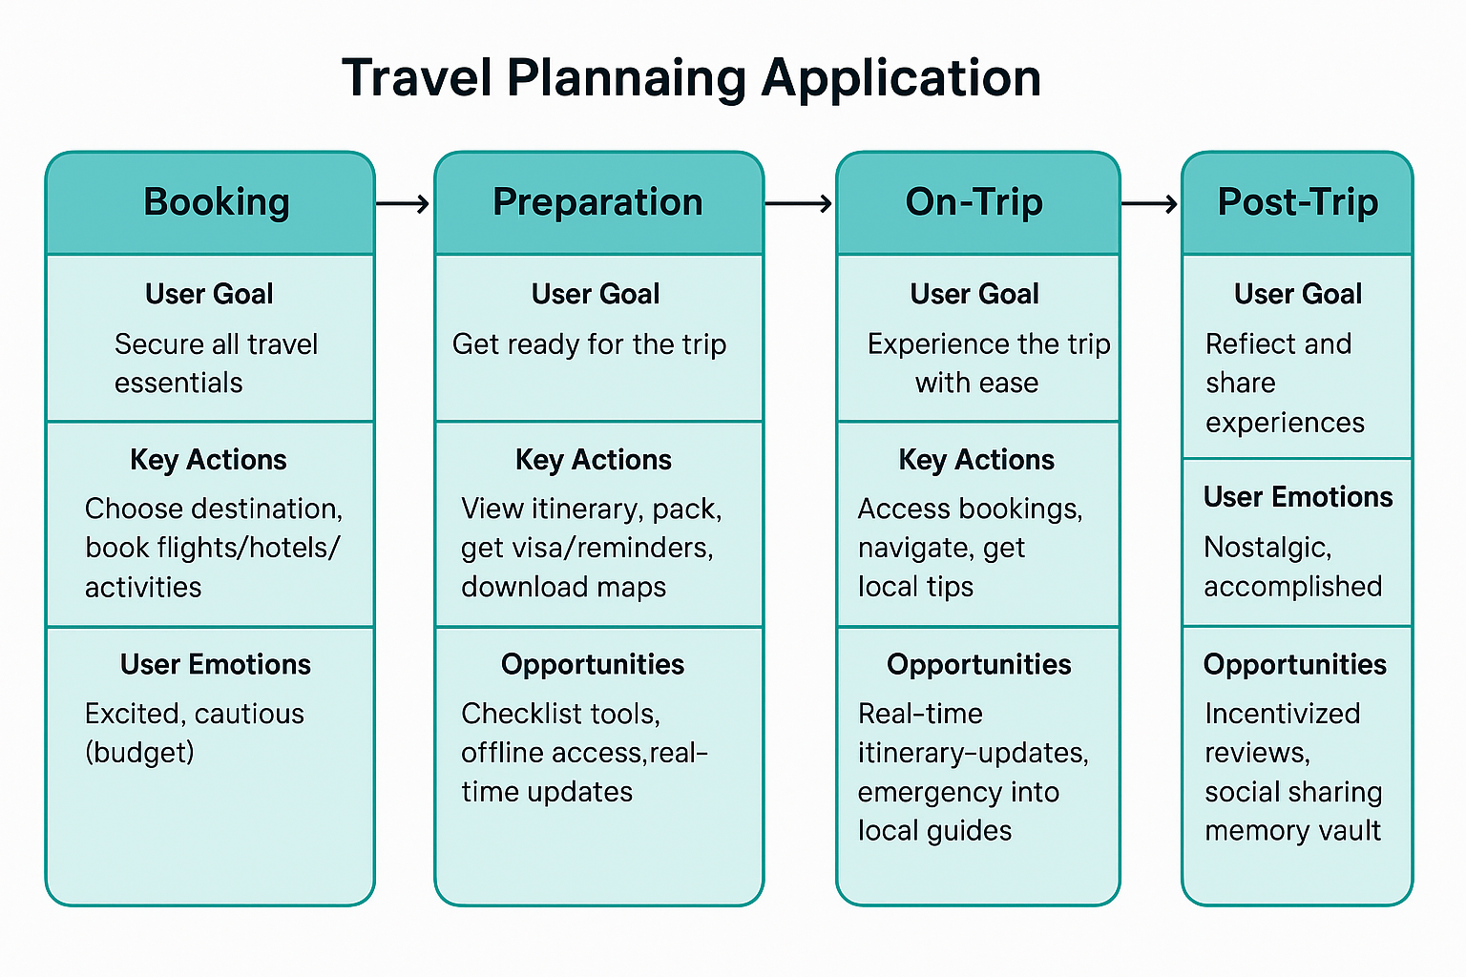
Task Flows

Slide 9
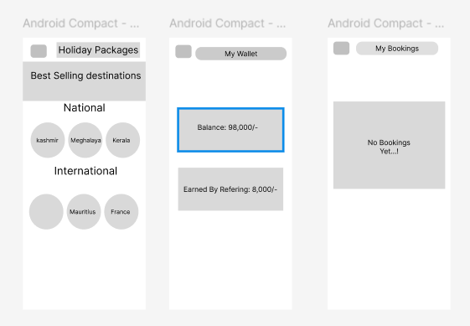
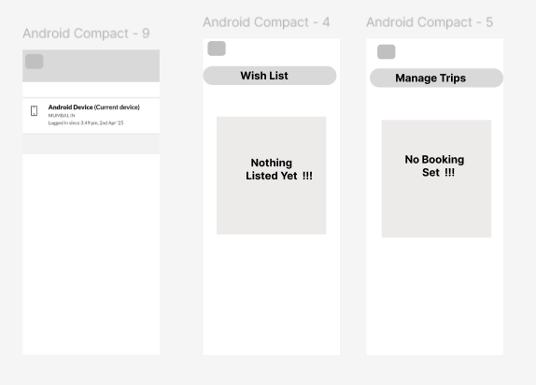
Low-Fidelity Wireframes

Slide 10
Link of Prototype
Protype link for Travel Planing Application
https://www.figma.com/proto/M3JBNdHonHijR15SJVpx91/Untitled?node-id=0- 1&t=HvSABwxs0uicAniw-1
Git Hub link
https://github.com/nimbalkar96k/UI-UX-for-Travel-Planing-Application-

